Slide 1
DESIGN & DEVELOPMENT OF FAKE NEWS DETECTION SYSTEM USING MACHINE LEARNING
Submitted By:-
Mannat Kaur Nagpal (1601410064) Prachi Gupta (1601410078)
Saumya Agarwal (1601410094)
Project Guide:- Mr. Ashish Agrawal Dept. CS SRMSCET

Slide 2
CONTENTS
What is Fake News?
Objective
Why is detecting fake news so important?
Innovativeness
Literature review
Requirements
Methodology & Approaches
Demonstration
Future Scope
References

Slide 3
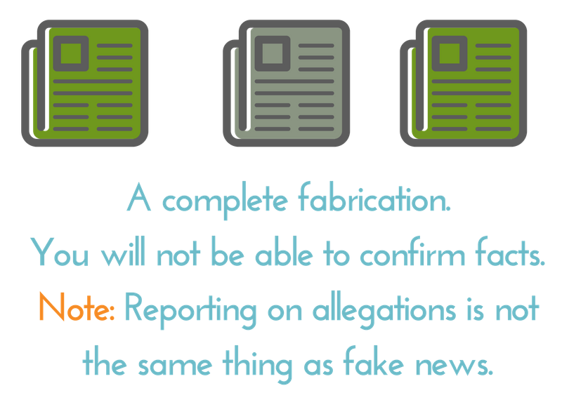
What is Fake News?

Slide 4
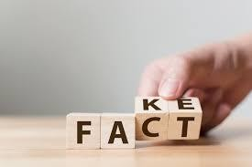
“The challenge of misinformation has been prevalent for years now and we still haven’t got our arms around it as a society.”

Slide 5
OBJECTIVE
The concept of fake news is not something new. It has been around for ages. But during the 2016 US presidential election, journalists began noticing a rash of viral made-up stories online. Later the way we look at fake news changed!
So we decided to build a model to detect fake from factual news stories published around that event.
Our objective is to build a model that can classify fake and real news from the subtle yet consistent differences in the language of the two classes of articles and also to provide the reader an interactive interface.

Slide 6
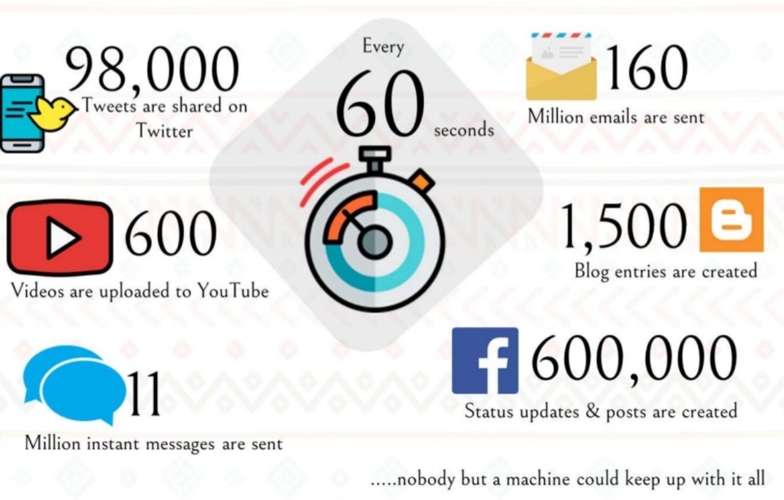
Why is detecting fake news so important?

Slide 7
INNOVATIVENESS
Why it’s better than any existing solution?
It provides an online platform and deals with real time scenarios for checking whether the news is fake or real, it is therefore quite an easy application to use.
The spectrum of true-to-false news will enable us to develop a new type of an auto-detection system capable of more ﬁne grained judgements.
We have currently developed such a solution using the Multinomial Naive Bayes technique in machine learning.
Inspiration: factmata.com funded by GOOGLE

Slide 8
LITERATURE REVIEW
S.NO. | PAPER TITLE | DATASET | TOOLS & TECHNOLOGY | ACCURACY
1 | Fake news detection using naive Bayes classifier | Liar dataset | Naive Bayes | 74%
2 | Fakebuster: Fake News Detection System Using Logistic Regression Technique In Machine Learning | Kaggle fake news dataset | Logistic Regression, TF-IDF | Training: 77.3% Testing: 56.2%
3 | Fake News Detection using Support Vector Machine learning Algorithm | BuzzFeed’s data | Support Vector Machine | Root relative squared error accuracy of 21.4997 %
4 | Self Multi-Head Attention-based Convolutional Neural Networks for fake news detection | Public dataset | Convolutional Neural Networks | Precision rate of 95.5% with a recall rate of 95.6%

Slide 9
REQUIREMENTS
Technology:
Python 3
Jupyter notebook
Web framework using FLASK
Techniques:
Text pre-processing techniques
NLP techniques (TF-IDF, Bag-Of-Words)
Multinomial Naive Bayes
Evaluation metrics and confusion matrix

Slide 10
WORKING OF MACHINE LEARNING

Slide 11
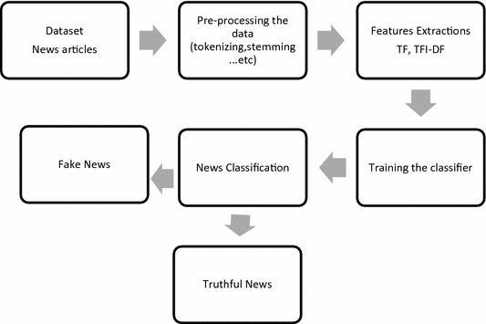
FLOWCHART

Slide 12
DATASET
The dataset we chose had real news articles from center, right and left aﬃliations and fake news articles ﬂagged as fake by Politifact, a fact-checking website.
It included 6K+ news articles with equal number of real and fake news.
Having a balanced dataset, we chose accuracy as my performance metric.
The dataset news.csv contains the title, text and labels as fake or real.

Slide 13
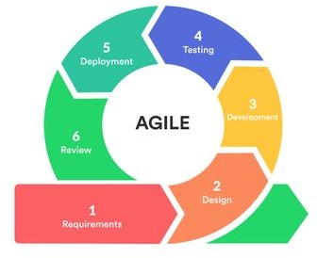
AGILE METHODOLOGY
Agile methodology is a practice that helps continuous iteration of development and testing in the SDLC process. Agile breaks the product into smaller builds.

Slide 14
METHODOLOGY
Data Preprocessing: Eliminate unnecessary text using tokenization, stemming, lemmatization, etc.
Feature Extraction: Performance of ML models depends widely on feature design so, we have extracted a wide range of features from the dataset using TF, TF-IDF, BOW, etc.
Classiﬁcation Approaches: Analyzed various algorithms and selected multinomial naive bayes that gave a subtle accuracy as compared to other machine learning algorithms.
Deployment: Implemented Machine learning code in the backend and created a user interface using Flask framework to scrap and detect fake news.

Slide 15
APPROACHES USED
Pickle: “Pickling” is the process whereby a Python object hierarchy is converted into a byte stream, and “unpickling” is the inverse operation, whereby a byte stream is converted back into an object hierarchy.
Flask App: It is a Web Server Gateway Interface (WSGI) web application framework designed to create web apps. It is super convenient and the code is simple.
Newspaper3k Library: Newspaper is an amazing python library for extracting & curating articles.

Slide 16
TF-IDF: Term Frequency-Inverse Document Frequency is a numerical statistic that is intended to reﬂect how important a word is to a document in a collection or corpus. Read about it here.
Multinomial Naive Bayes: It relies on Relies on very simple representation of document as a ‘Bag of words’. It estimates the conditional probability of a particular word given a class as the relative frequency of term t in documents belonging to class(c), in our case Fake or Real. A simple explanation on this link.

Slide 17
It’s not enough to know if a model works, we need to know how it works.
— Sundar Pichai, CEO, Google
So let’s see how this project works……

Slide 18
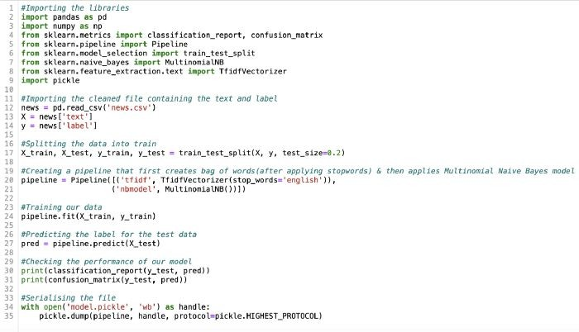
BUILDING THE MODEL

Slide 19
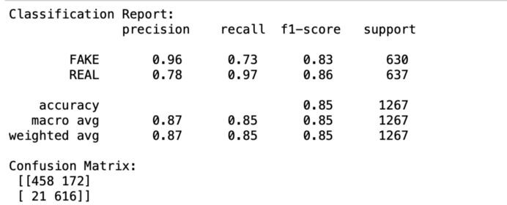
CLASSIFICATION REPORT

Slide 20
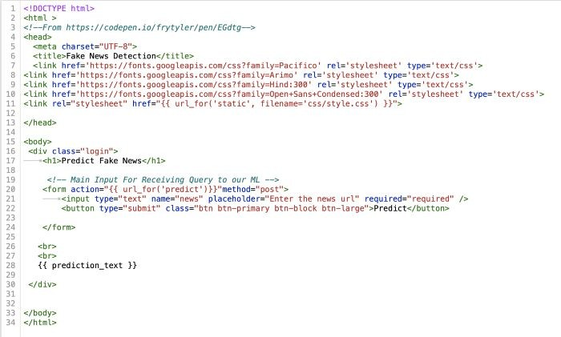
INTERFACE

Slide 21
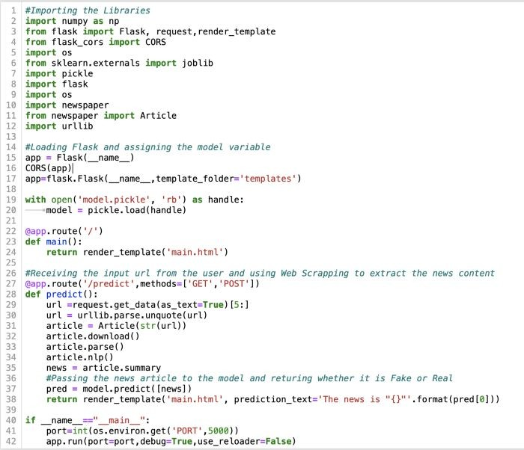
FLASK APP

Slide 22
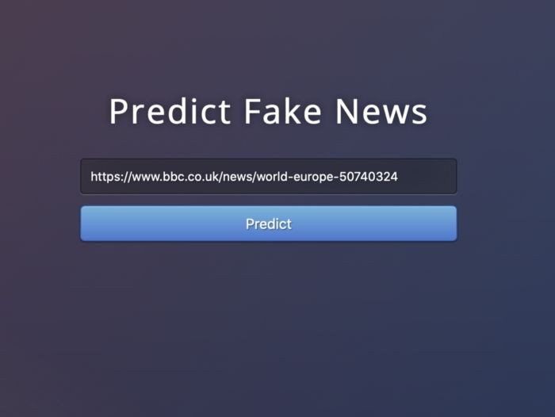
INTEGRATE

Slide 23
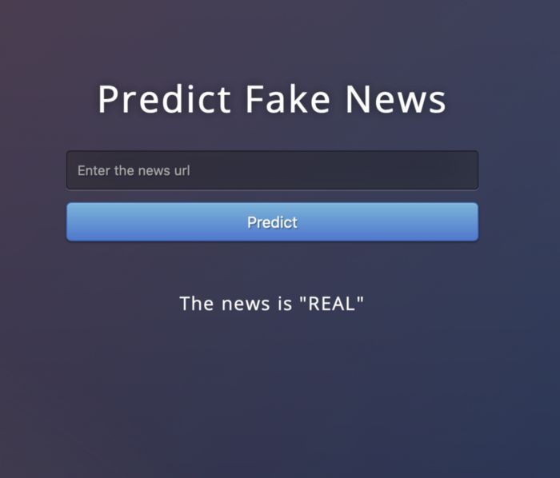
OUTPUT

Slide 24
CONCLUSION
Through the work done in this project, we have shown that machine learning certainly does have the capacity to pick up on sometimes subtle language patterns that may be diﬃcult for humans to pick up on.
The main contribution of this project is support for the idea that machine learning could be useful in a novel way for the task of classifying fake news.
The application also provides a way to see manually how the model is implemented.

Slide 25
FUTURE SCOPE
This model identiﬁes fake from real news by identifying the subtle but consistent differences in the language of the articles. To add more power to the model, source of the text can also be taken into consideration. If the source is trusted, we can take it as real news on the other hand if the source is from a notorious fake news handle, then we wouldn’t even have to look at the text data to ascertain the authenticity of the article
We can increase the reach of our product to the users by developing
browser add-ons.
Updating the dataset to keep up with the growing number of articles. This would need to be followed by re-training and
re-evaluating the model at every stage of updating.

Slide 26
REFERENCES
Yong Fang, Jian Gao,Cheng Huang, Hua Peng,Runpu Wu “Self
Multi-Head Attention-based Convolutional Neural Networks for fake news detection” in journal.pone September 26, 2019
Sairamvinay Vijayaraghavan, Ye Wang, Zhiyuan Guo “Fake News
Detection with Different Models” in cornell university Sat, 15 Feb 2020
https://www.analyticsvidhya.com/blog/2019/04/datahack-radio-m achine-learning-identify-fake-news-mike-tamir/
https://towardsdatascience.com/using-a-i-to-combat-fake-news-34 f5a51907d6

Slide 27
THANK YOU!

